Slide 1
Elementary Discrete Time Signals lecture 5

Slide 2
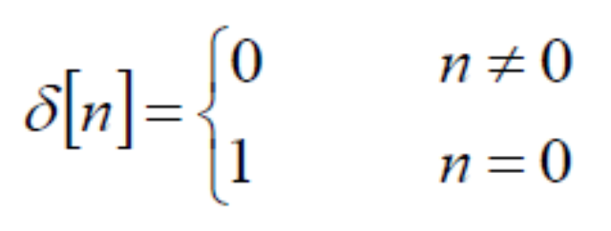
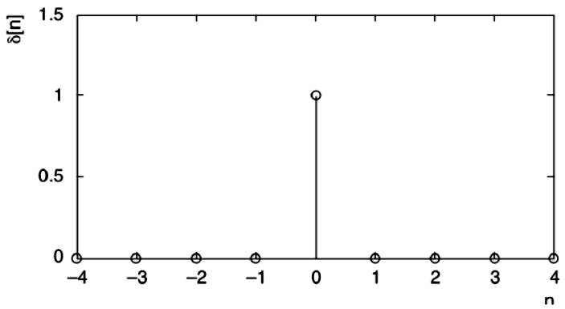
Discrete Time Unit Impulse Function
The unit impulse function or unit sample sequence is defined as the sequence with values

Slide 3
Discrete Time Unit Impulse Function
Determine the following:
δ[0]
δ[3]
δ[-2]
Answers
δ[0] = 1
δ[3] = 0
δ[-2] = 0

Slide 4
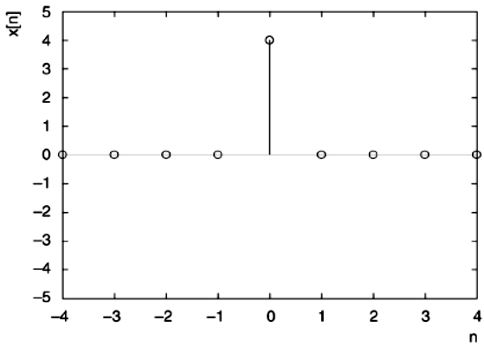
Scaled Unit Impulse Function
Draw the signal: x[n] = 4δ[n].

Slide 5
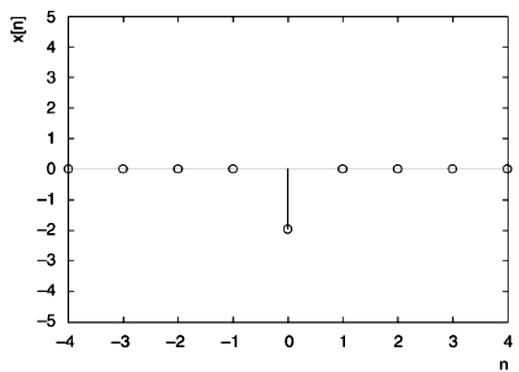
Scaled Unit Impulse Function
Draw the signal: x[n] = -2δ[n].

Slide 6
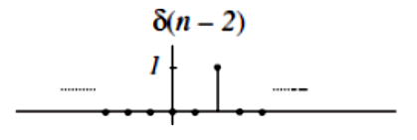
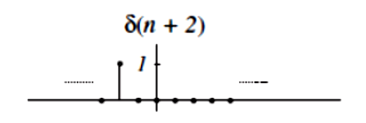
Shifted Unit Impulse Function
Example: Draw the following signals:
x[n] = δ[n - 2]
x[n] = δ[n + 2]

Slide 7
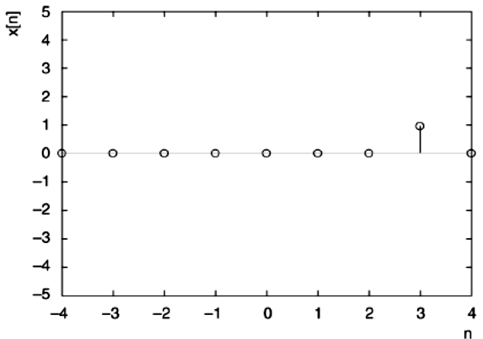
Shifted Unit Impulse Function
Example: Draw the following signals: x[n] = δ[n - 3].

Slide 8
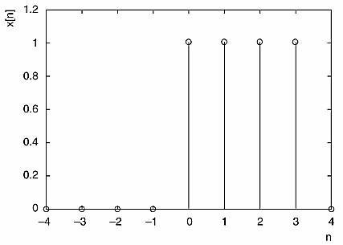
Discrete Time Unit Impulse Function
Example: Write a function to describe the signal in the figure.
x[n] = δ[n] + δ[n-1] + δ[n-2] + δ[n-3]

Slide 9
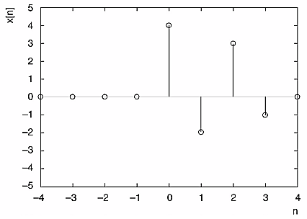
Discrete Time Unit Impulse Function
Example: Write a function to describe the signal in the figure.
x[n] = 4δ[n] - 2δ[n-1] + 3δ[n-2] - δ[n-3]

Slide 10
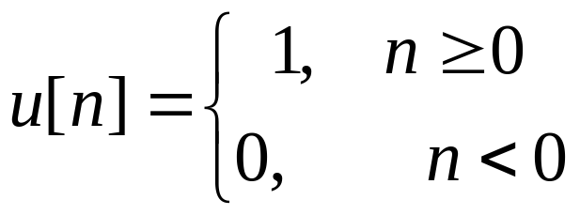
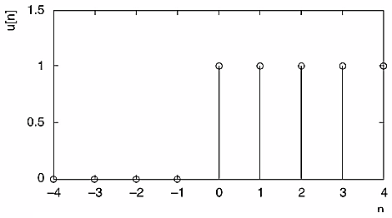
Discrete Time Unit Step Function
The discrete time version of the unit-step function is defined by
Which is illustrated in figure below.

Slide 11
Discrete Time Unit Step Function
Example: Determine the values of the following
u[-1], b) u[0], c) u[1]
Answers
u[-1] = 0
u[0] = 1
u[1] = 1

Slide 12
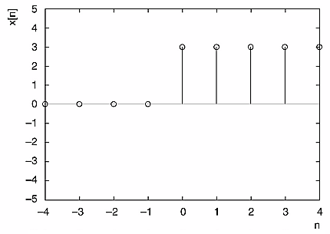
Scaled Unit Step Function
Example: Draw the signal x[n] = 3u[n]

Slide 13
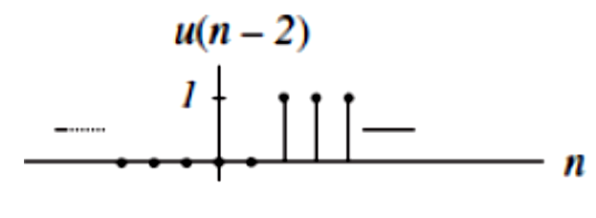
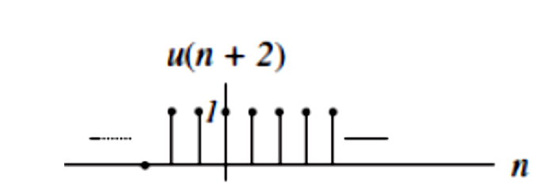
Shifted Unit Step Function
Example: Draw the signal x[n] = u[n - 2], and x[n] = u[n + 2]

Slide 14
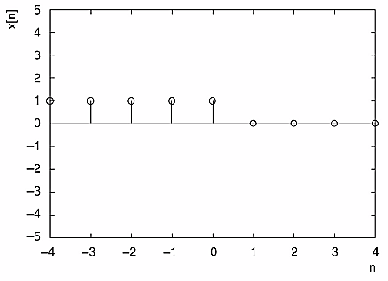
Unit Step Function
Example: Draw the signal x[n] = u[-n].

Slide 15
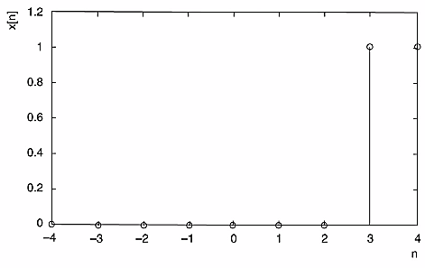
Unit Step Function
Example: Draw the signal x[n] = u[n - 3].

Slide 16
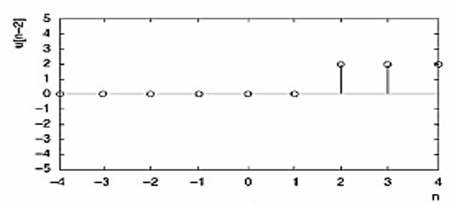
Unit Step Function
Draw the signal , x[n] = u[n] + 2u[n - 2].

Slide 17
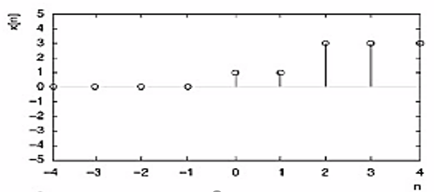
Unit Step Function

Slide 18
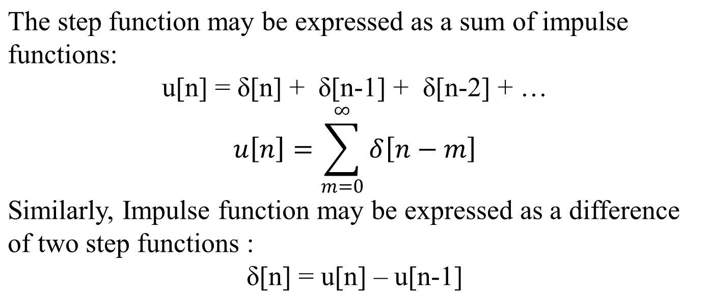
Connection Between Unit Impulse and Unit Step Function

Slide 19
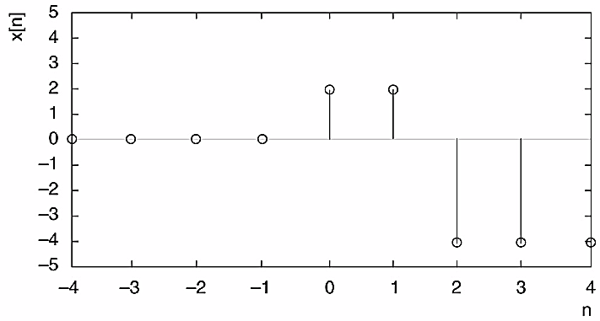
Connection Between Unit Impulse and Unit Step Function
Example: Write a function to describe the signal shown in the figure using Unit Impulse and Unit Step function.
Unit Impulse Function
x[n] = 2δ[n] + 2δ[n-1] - 4δ[n-2] - 4δ[n-3] -4δ[n-4] -……….
Unit Step Function
x[n] = 2u[n] – 6u[n-2]

Slide 20
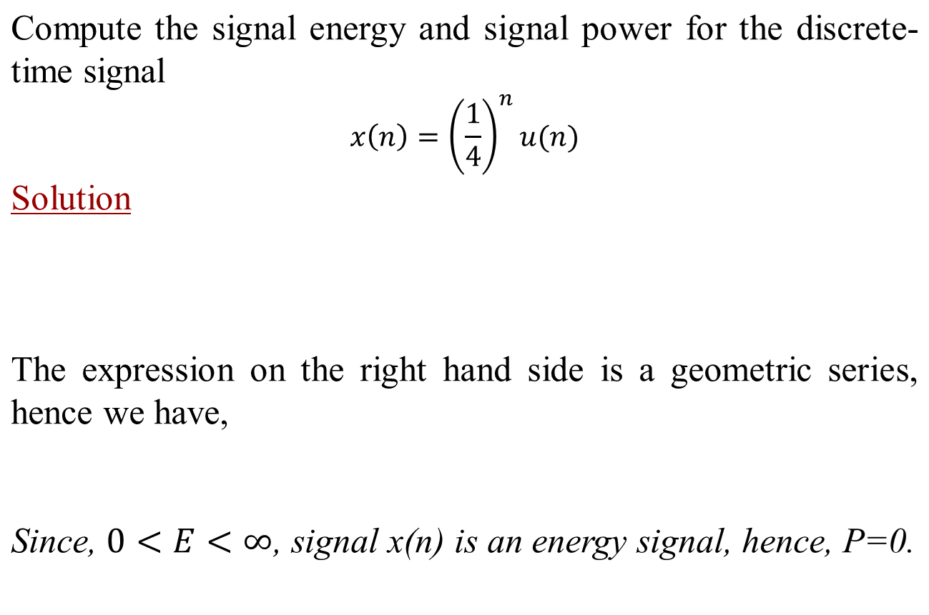
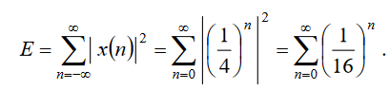

Discrete Time Unit Step Function

Slide 21
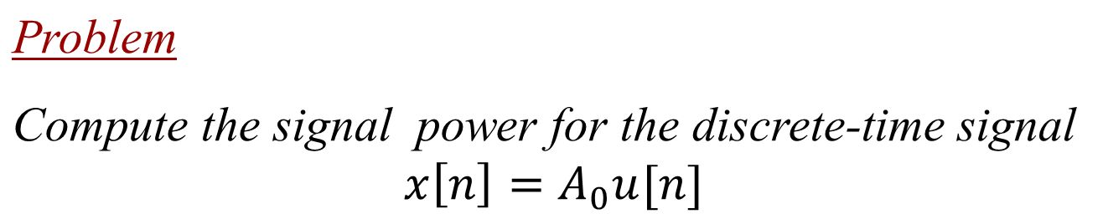
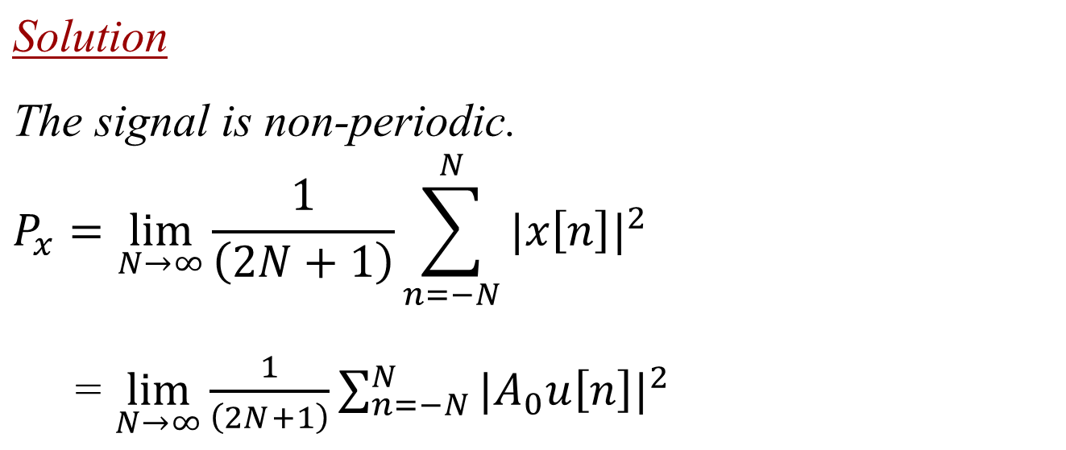
Discrete Time Unit Step Function

Slide 22

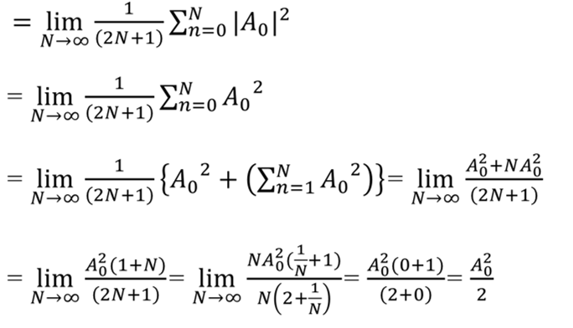
Discrete Time Unit Step Function

Slide 23
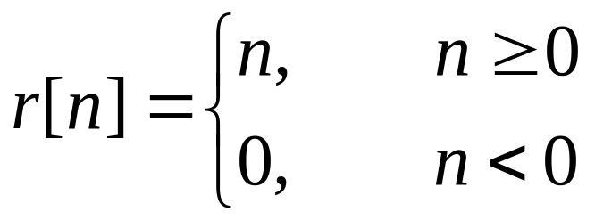
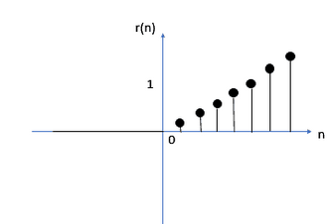
Discrete Time Unit Ramp Function
  The discrete time version of the ramp function is defined by
  Or, equivalently, r[n]=nu[n]

Slide 24
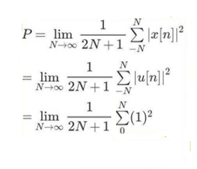
Power of Unit Step Function

Slide 25
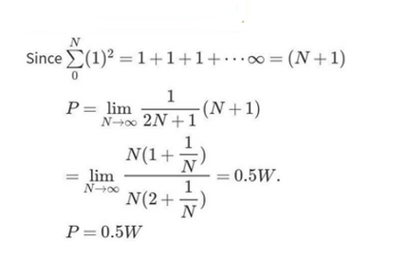
Discrete Time Ramp Function

Slide 26
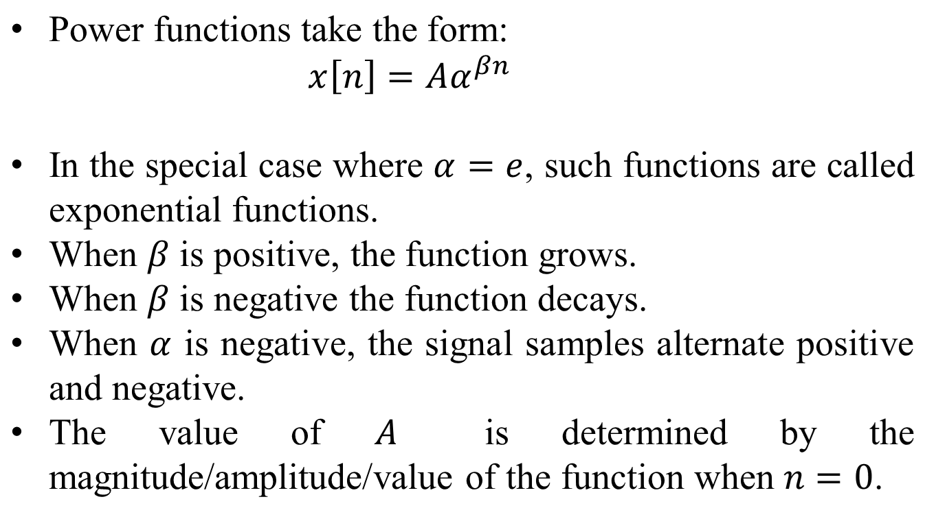
Discrete Time Power Function

Slide 27
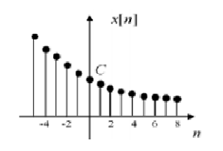
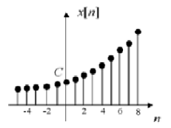
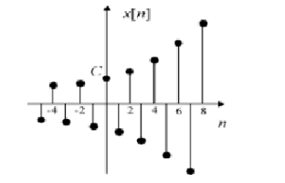
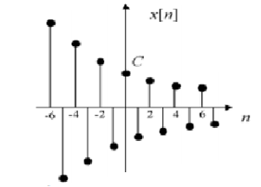
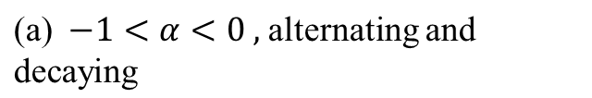
Discrete Time Power Function

Slide 28
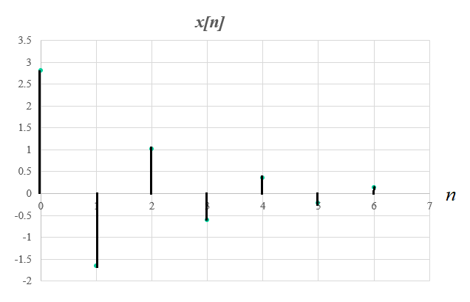
Discrete Time Power Function
n | 0 | 1 | 2 | 3 | 4 | 5 | 6
x[n] | 2.8 | -1.66 | 1.01 | -0.61 | 0.36 | -0.22 | 0.13

Slide 29
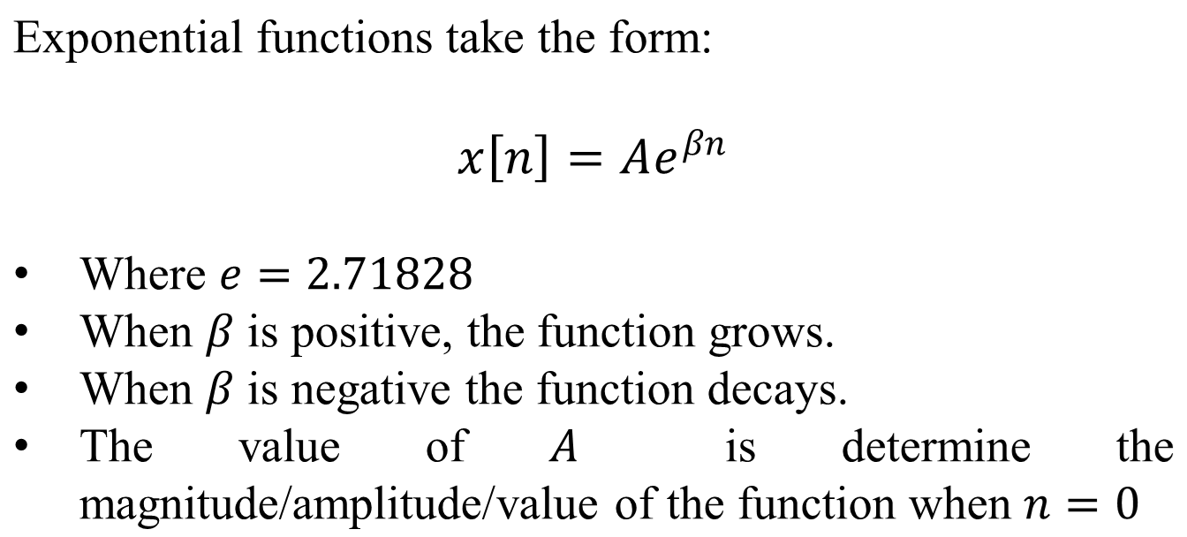
Discrete Time Exponential Function

Slide 30
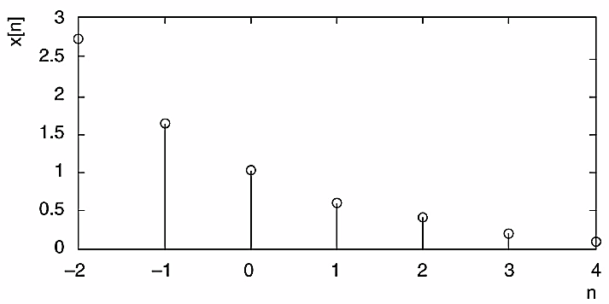
Discrete Time Exponential Function

Slide 31
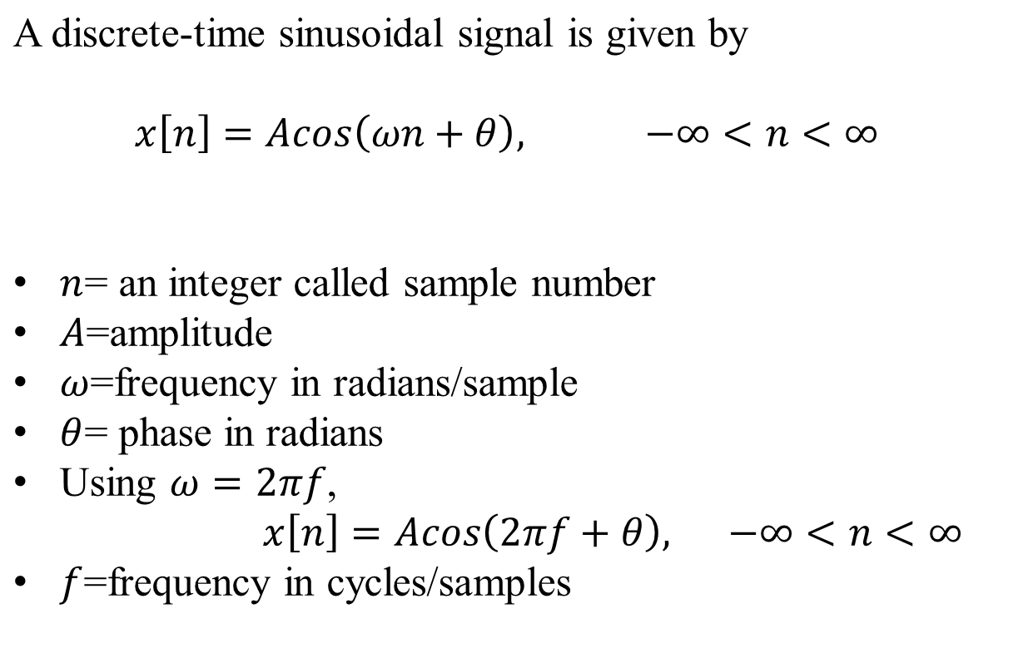
Discrete Time Sinusoid Signal

Slide 32

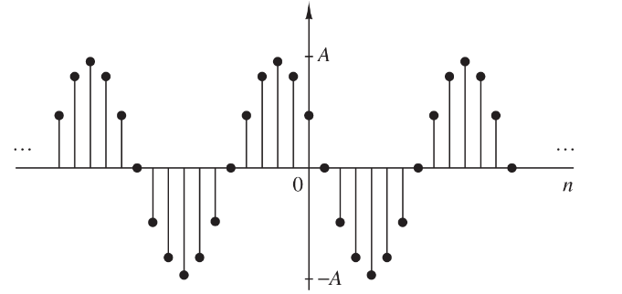
Discrete Time Sinusoid Signal

Slide 33
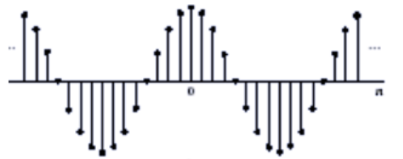
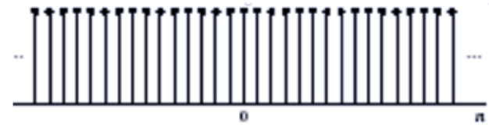

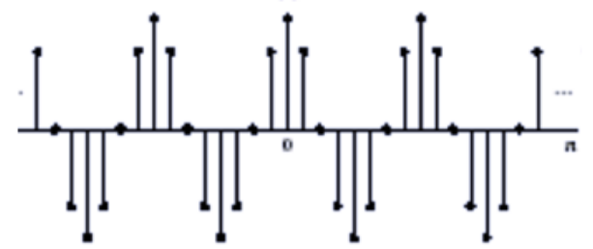
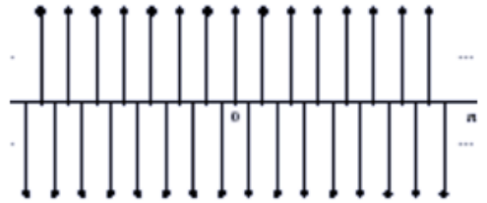

Discrete Time Sinusoid Signal

Slide 34

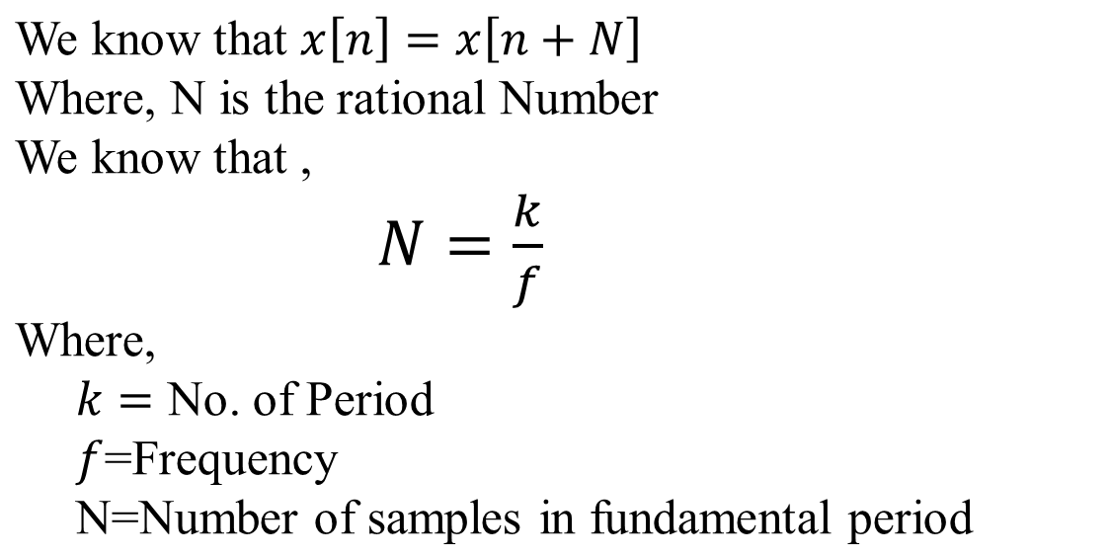
Explanation of the following figure

Slide 35
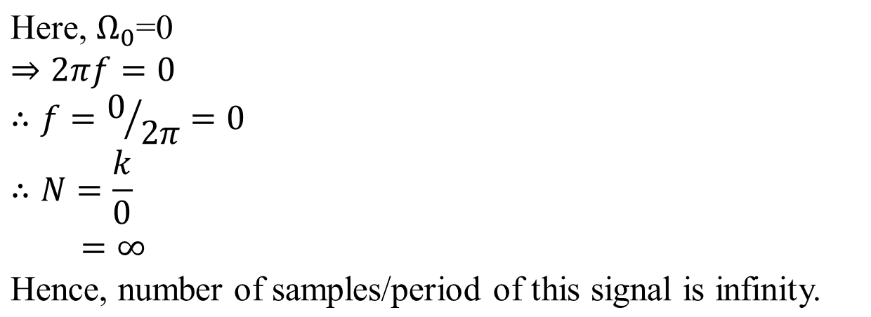
Explanation of the following figure

Slide 36
Rational Number
A rational number is any number that can be written as a fraction, where both the numerator (the top number) and the denominator (the bottom number) are integers, and the denominator is not equal to zero. Irrational numbers are real numbers that cannot be represented as simple fractions. An irrational number cannot be expressed as a ratio, such as p/q.

Slide 37
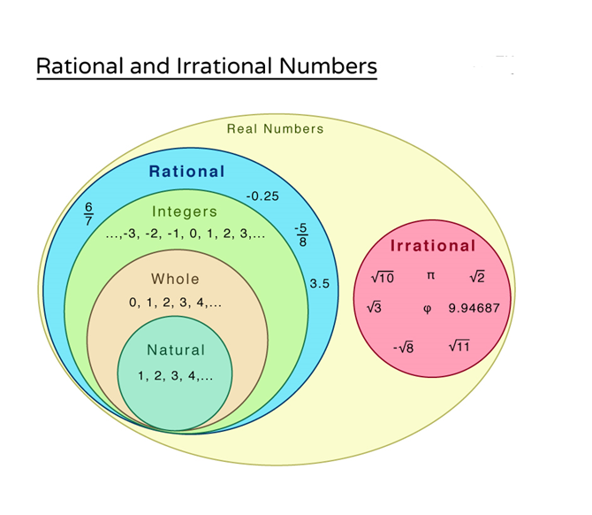
Rational Number

Slide 38
End

